Slide 1
SBOM Sprint #4
Thomas Eby, Pranav Gonepalli, Evan Hellersund, Manel Leong,
Camron Rule, Skyler Walker, Duohan Xu, Rachel Zheng
College of William & Mary
CSCI 435: Software Engineering
November 6, 2024

Slide 2
Sprint Goal
Implement templates for other pages and repair the backend to correctly parse all SBOMs.

Slide 3
Sprint Backlog - Front end
Create page navigation
Create content on each page (functionality will be added later)
Quality of life and usability changes for tree visualization
Expand/collapse all levels
Highlight for selected nodes
Improve documentation

Slide 4
Sprint Backlog - Backend
Create SPDX 2.2, 2.3 Json Parser
Create TreeBuilder and backend Tree Object
Create id-data-map endpoint
Get tree endpoint working
Added feature flags
Identified security vulnerabilities in a SBOM, severity distribution, and top 10 vulnerabilities

Slide 5
Sprint Backlog - Backend
Works in progress
SPDX 3.0 Json parsing
SPDX License data parsing
Implemented in the 2.2 and 2.3 Json versions
Almost complete in 3.0 Json
Licence frequency map & license to component id map
No endpoint set up for it yet
Connect security info with the rest of the backend

Slide 6
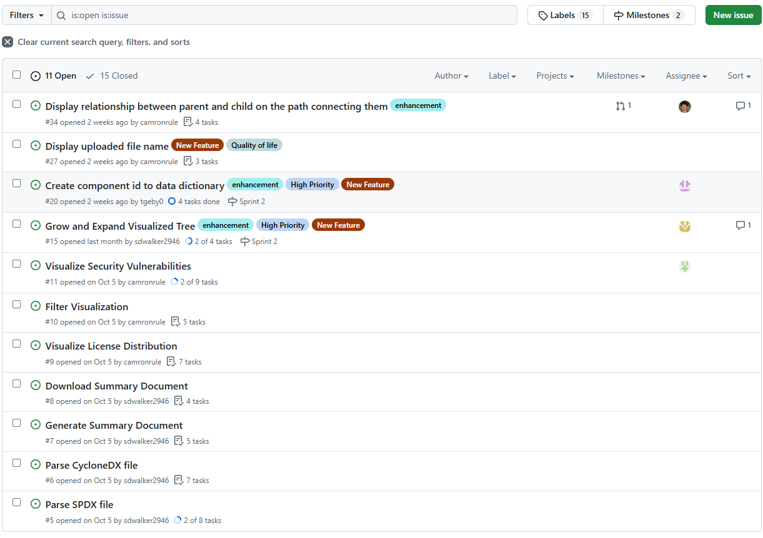
Issue Tracker

Slide 7
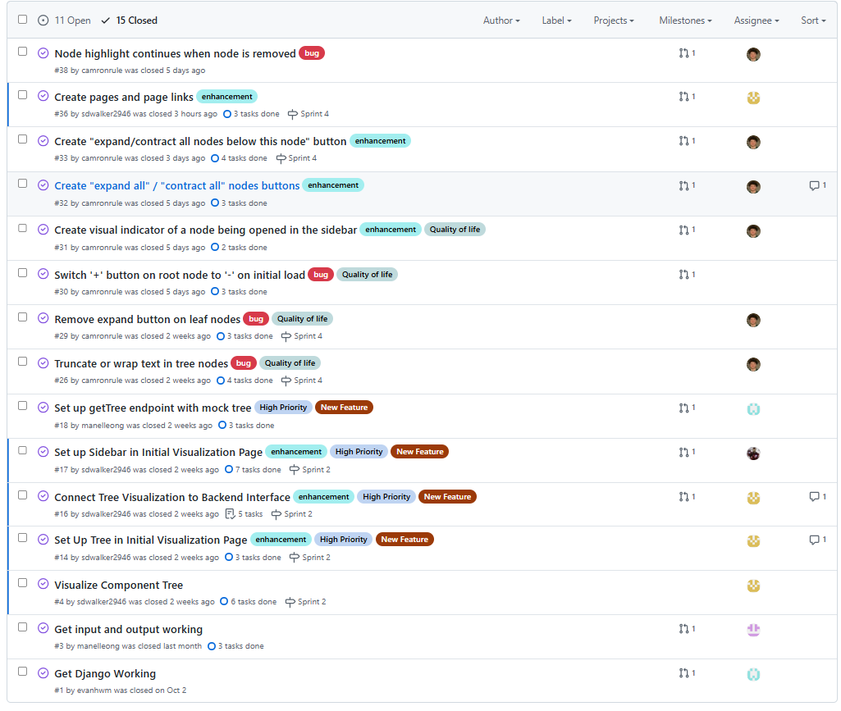
Issue Tracker (Continued)

Slide 8
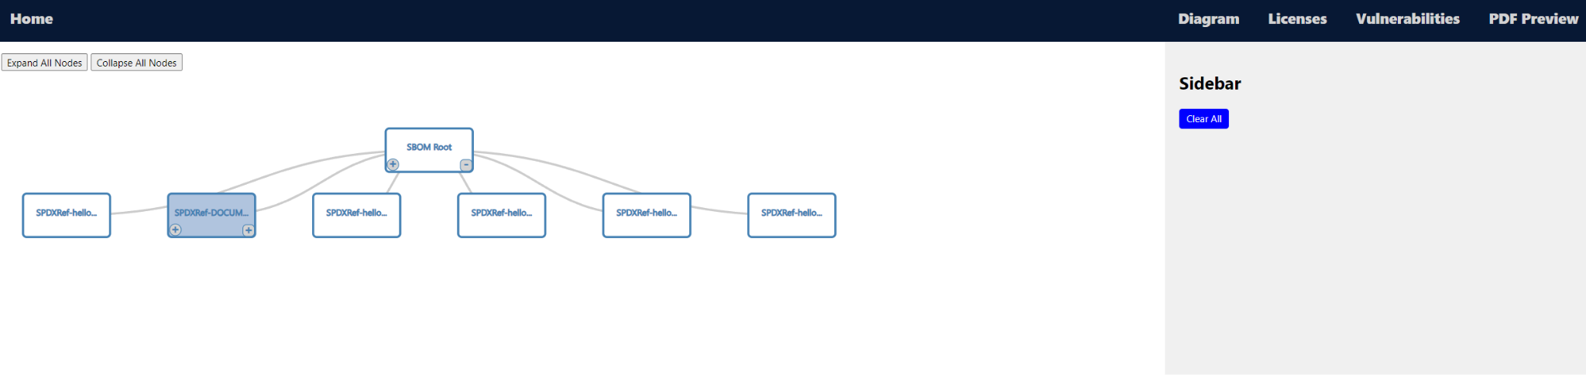
Tree Visualization Page

Slide 9
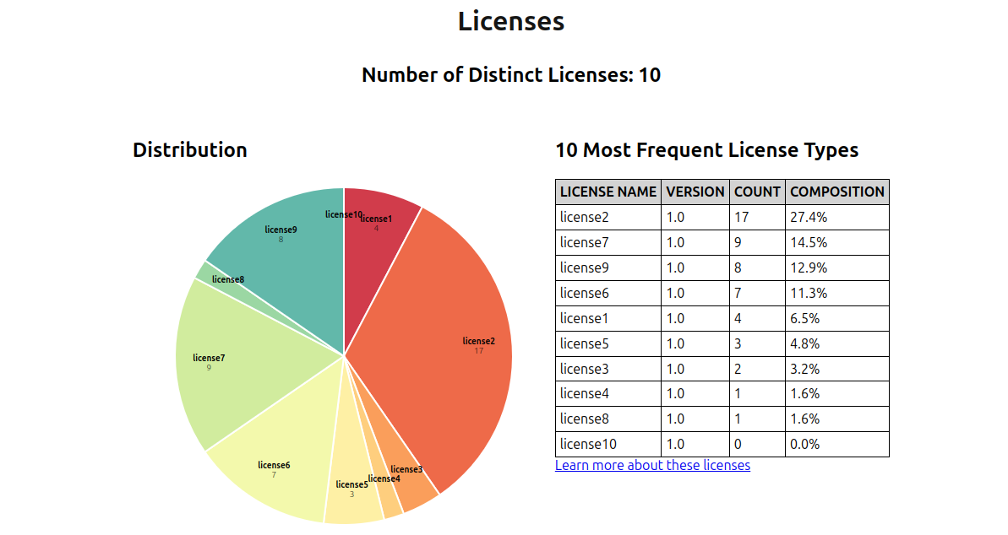
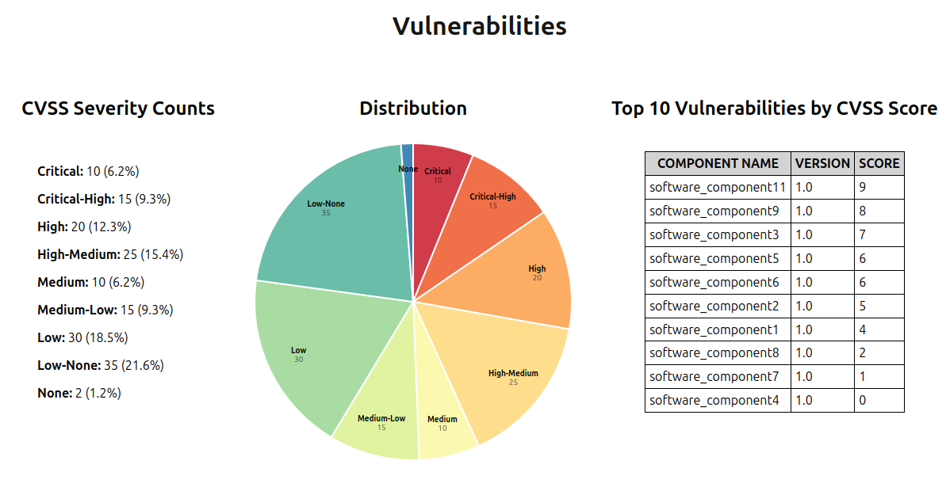
Licenses and
Vulnerabilities Pages

Slide 10
Demo

Slide 11
Scanning for Security Vulnerabilities
Found a new tool: trivy
Pros: returns more information for vulnerabilities
Cons: seems to have more trouble working with some versions of sboms or if sboms are not in a specific format
Idea: use trivy first and if that fails use bomber (would have to find package/api that can get more info)
Wrote a script to reformat output from a trivy scan
Includes summary and top 10 info

Slide 12
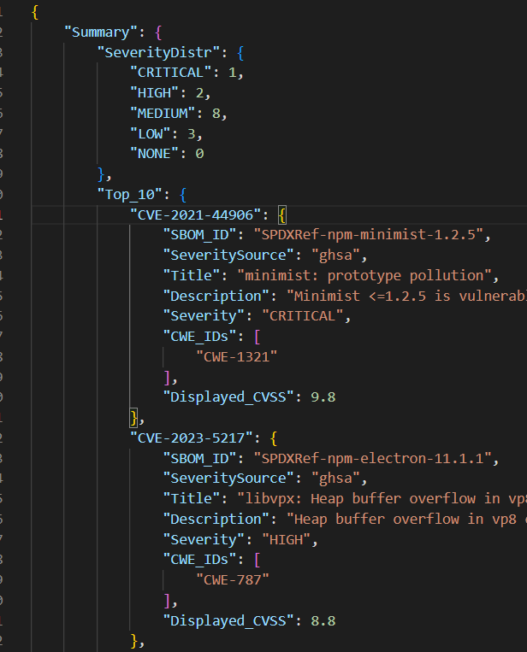

Slide 13
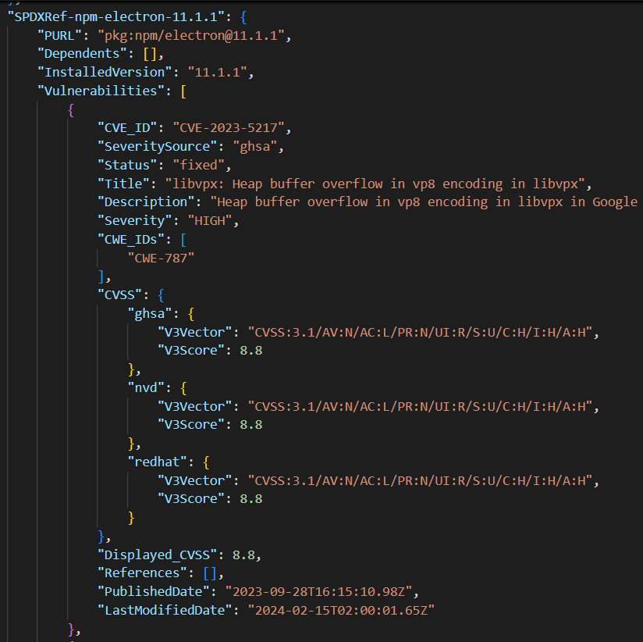

Slide 14
Next Sprint Backlog
Integrate vulnerability analysis into backend and display in frontend.
Implement license analysis in backend to display in frontend.
Figure out how to generate and display a PDF.
Add component details to sidebar in tree visualization page.

Slide 15
Lessons
Backend tasks becoming numerous, need to redistribute labor to backend team.

Slide 16
Contributions
Manel: Made TreeBuilder, Tree object, and got getTree endpoint working with parser.
Skyler: Added remaining pages, page transition functionality. Added content to licenses and PDF overview pages.
Thomas: Implemented SPDX 2.2 and 2.3 JSON parser
Pranav: Was really busy this sprint and wasn’t able to make much progress on my end.
Camron: Implemented many QOL and bug fixes for the tree. Helped put together and style new pages.
Rachel: Worked on identifying security vulnerabilities, summarizing results, and formatting output from vulnerability scanners
Evan: Was also busy and did not get much work done.
Duohan: Implementing SPDX 3.0 JSON parse, preparing tests for CycloneDX formats
Everyone:

